Slide 1
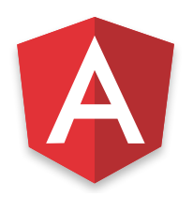

Introduction to Ngrx
Timmy Tom Tata Consultancy Services

Slide 2
Ngrx
RxJS powered state management for Angular applications, inspired by Redux.
Three main pieces of Ngrx : single store, reducers, actions.
The primary characteristics is that state is centralized, events flow up and state flows down.

Slide 3
How it works?
reducers
server
new state
http
store
actions
effects
services
App Component
Child Component
Child Component
dispatch

Slide 4
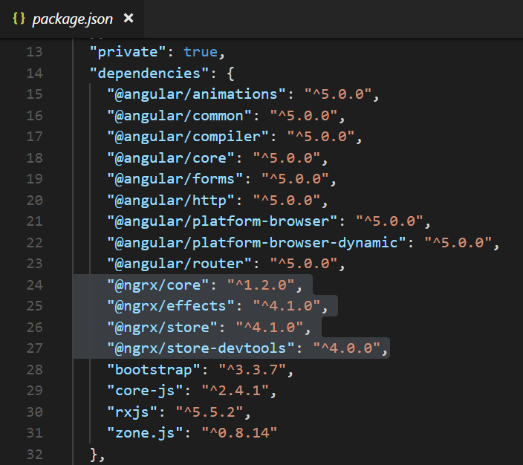
Install:
npm install @ngrx/core @ngrx/store @ngrx/effects --save
npm install @ngrx/store-devtools --save

Slide 5
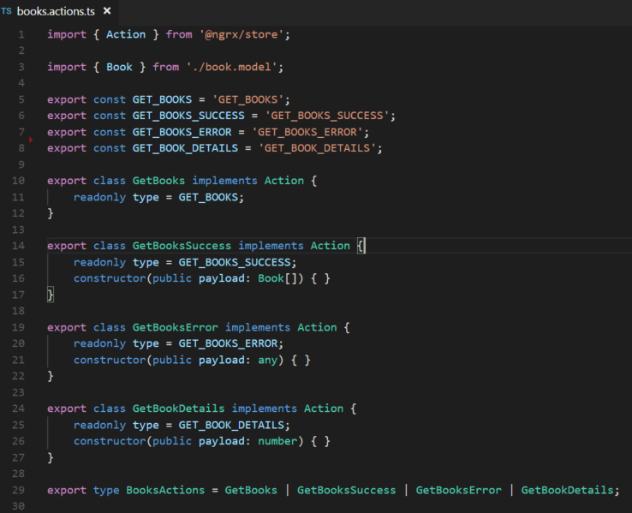
Actions
-> communicate to the Reducers when the state needs updated
‘Action’ is a simple interface that ngrx/store provides
It contains two properties:
'type' -> is a string, denoting what change in state has occurred.
'payload [Optional] ->' is a JavaScript object containing any data that is associated with that state change.

Slide 6
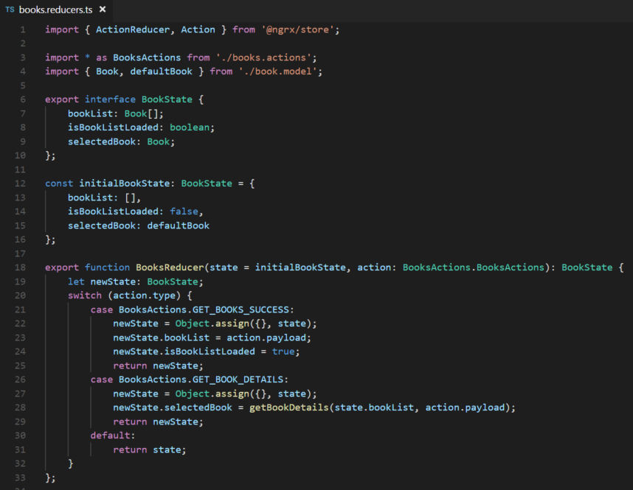
Reducers
-> It’s a pure function that given a state, and an action, will return a new state.

Slide 7
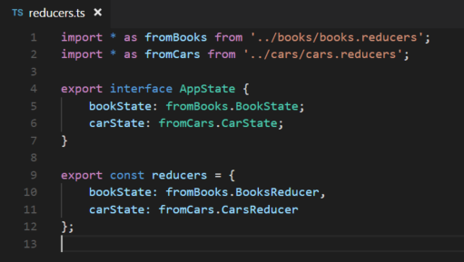
AppState and Combine all reducers
AppState interface is just a simple final representation of the state for the entire app. We’ll use this later when we are grabbing a reference to the store and selecting data from it.
Combine all the reducers , so that it will act as a parent reducer which will invoke each child reducer with the previous slice of state and action each time an action is dispatched.

Slide 8
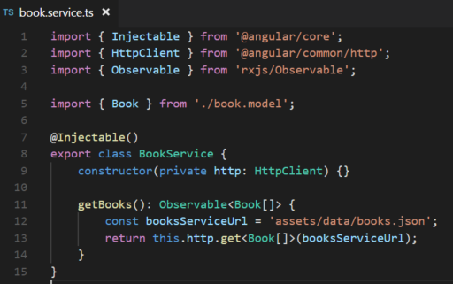
Service Class to communicate with server
Simple Typescript class and its public function return type is of Observable.

Slide 9
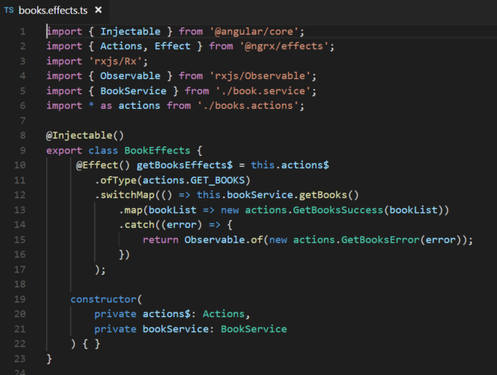
ngrx/effects
-> listens for actions being dispatched to the store and can generate a new action and dispatches it.
We subscribe to ‘this.actions$’ Observable and listen to actions ofType ‘GET_BOOKS’
Then we call switchMap on that as we’re going to get a whole new observable from the service.
The subsequent map call then operates on a list of books from the service.
We pass that response list to respective success action.
Ngrx/effects then will take care of dispatching this new action to the store.

Slide 10
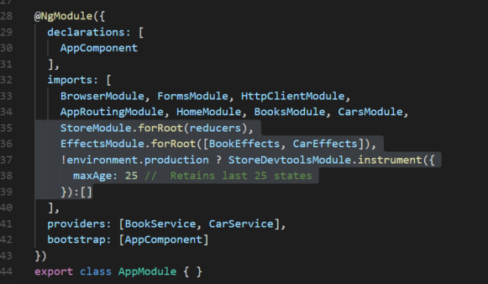
StoreModule & EffectsModule

Slide 11
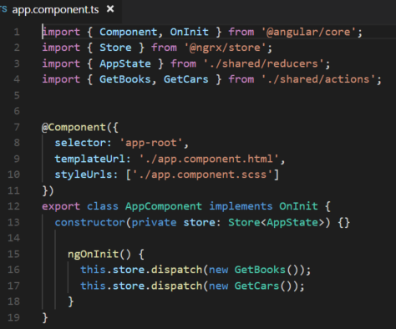

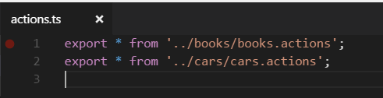
Dispatching action from a component
If we have multiple actions file, we can export all the actions in a common action file under shared folder.

Slide 12
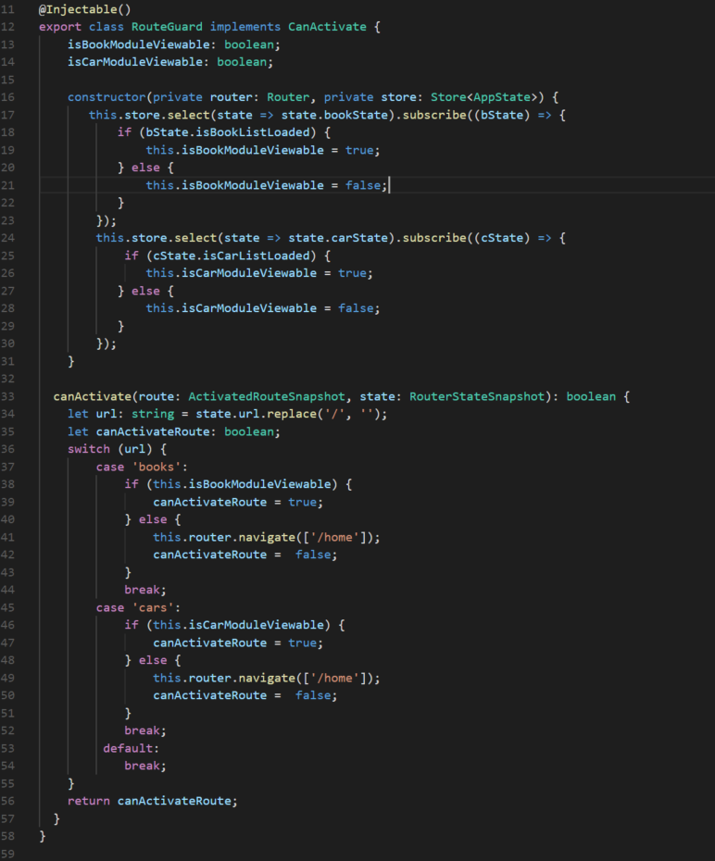
Route Guard

Slide 13
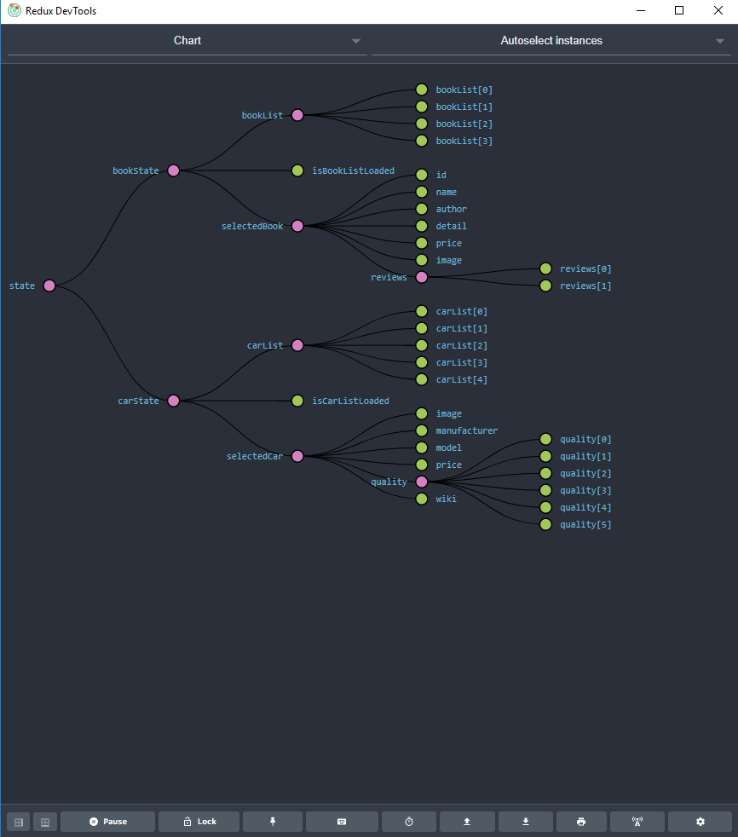
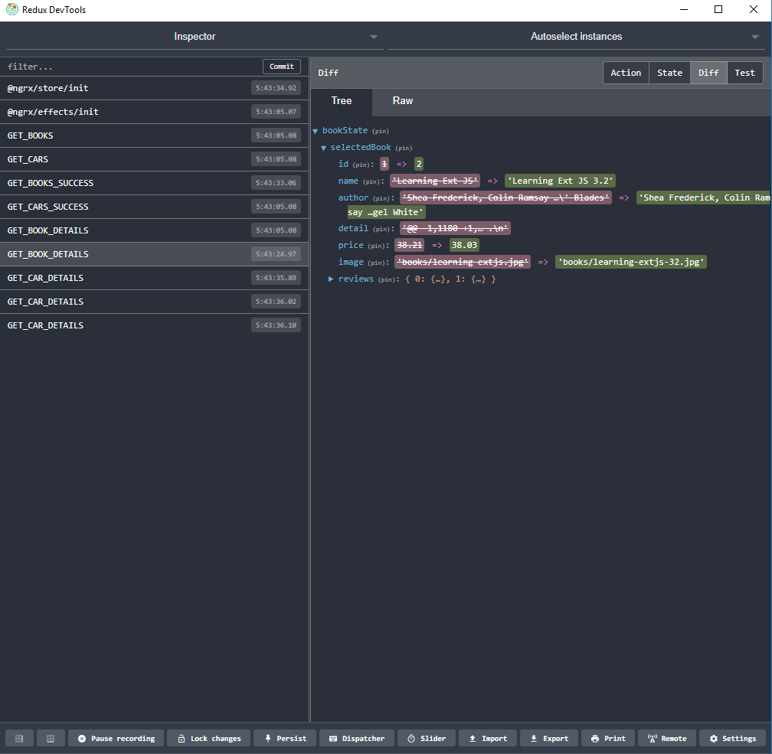
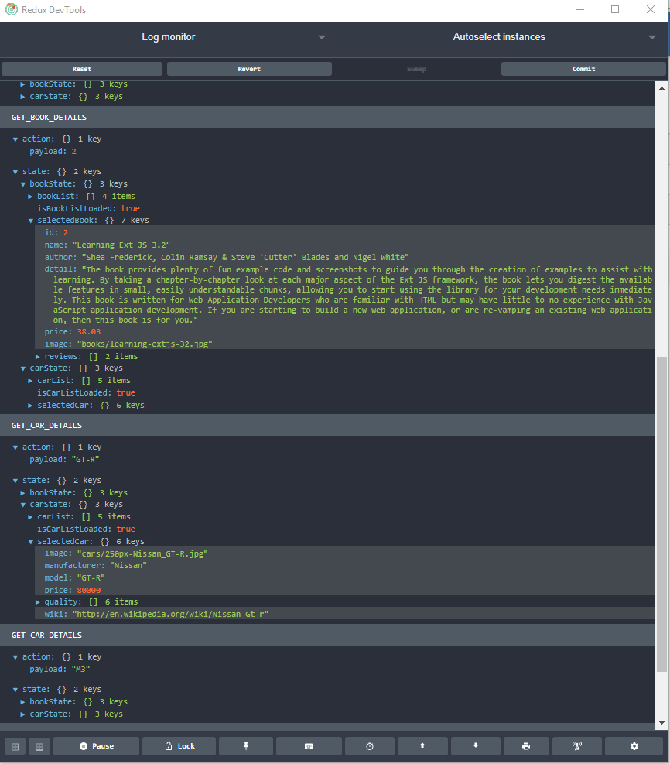
StoreDevtools

Slide 14
Container and Dump component Error Handling
Route Guard
Unit test Store Dev Tool
DEMO
https://github.com/timmyktom/angular_ngrx_example/tree/Angular5-Ngrx4/example-angular-ngrx
Meet up Link: https://www.meetup.com/ng-sydney/events/237320696/

Slide 15
Thank You

